Slide 1
Transradial Prosthetic Arm
Kendall Gretsch
Team Members: Henry Lather, Kranti Peddada
Clients: Dr. Charles Goldfarb and Dr. Lindley Wall

Slide 2
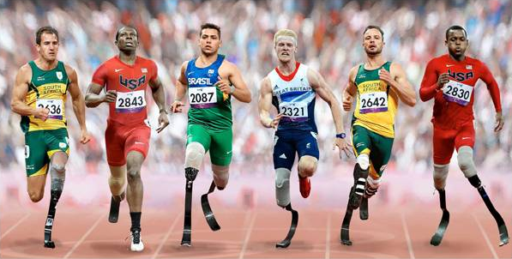
Background
In US 2005:
  1.2 million amputees
    541,000 upper limb amputees
      43,000 amputees with major upper limb loss
Lower limb prostheses are highly functional
http://www.standard.co.uk/incoming/article8112868.ece/ALTERNATES/w620/70newparaletesmain.jpg

Slide 3
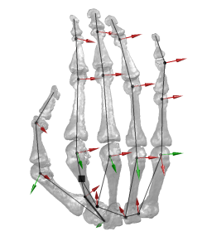
Background
Upper limb prostheses have a long way to go
Human hand and arm are complex
  3 degrees of freedom in shoulder
  1 degree of freedom in elbow
  27 degrees of freedom in hand and wrist
http://www.dlr.de/rm/Portaldata/52/Resources/images/institute/robotersysteme/bionics/24dof(6deg3mm)g_250px.png

Slide 4
Existing Technology
Three general types of prosthetic devices:
  Passive
  Body-powered
  Externally-powered

Slide 5
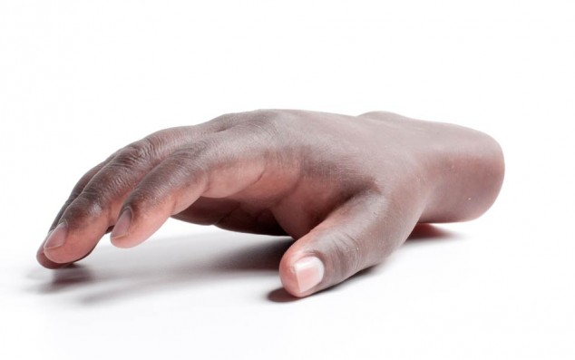
Passive Devices
Advantages
  Cosmetic
  Can be nearly indistinguishable from sound hand
Disadvantages
  Low functionality
"Living Skin" by Touch Bionics

Slide 6
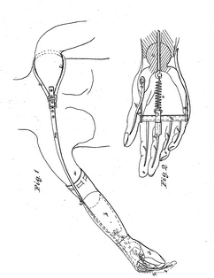
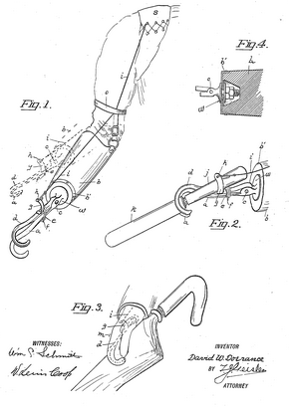
Body-powered Devices
1857: Body Powered Shoulder Harness
William Selpho
1912: Split Hook
David Dorrace
https://www.google.com/patents/US18021?dq=1857+patent+to+William+Selpho&hl=en&sa=X&ei=onVHUoGCIKqC2QXj3YDADg&ved=0CDcQ6AEwAA
http://patentimages.storage.googleapis.com/pages/US1042413-0.png

Slide 7
Body-powered Devices
Advantages
  Durable
  High level of accuracy and speed
  Less expensive: $4,000 - $8,000
Disadvantages
  Discomfort from shoulder harness
  Mechanical appearance

Slide 8
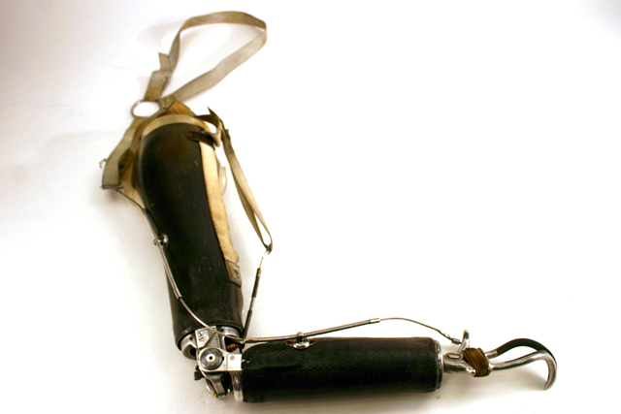
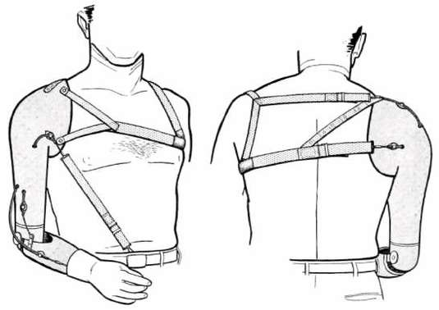
Body-powered Devices
Transhumeral
Device
Harness System
http://www.mtb-amputee.com/images/Arm1.jpg
http://www.oandplibrary.org/al/images/1955_03_026/tmp48A-26.jpg

Slide 9
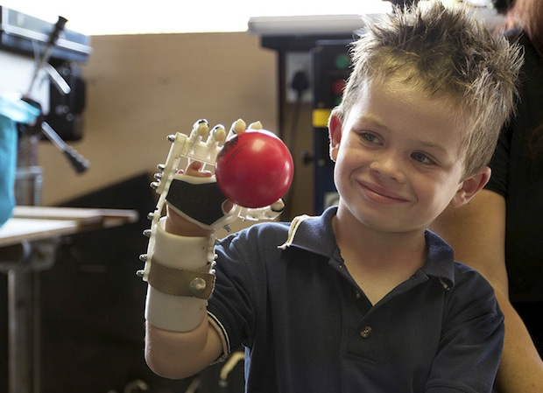
Body-powered Devices
Robohand-Richard Van As
  Low cost 3D printed prosthesis
http://spectrum.ieee.org/img/MB_RH_1119_low-1368212473079.jpg

Slide 10
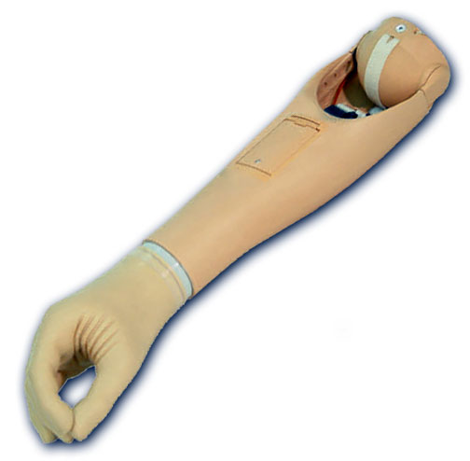
Externally-powered Devices
Commonly use EMG signals from residual limb
Focus of current research
Advantages
  Potential for higher functionality
  Life-like hands
  Powerful grip
Disadvantages
  Very expensive: $25,000+
  Cannot be used in dirty environments
  Slow finger movement
  No sensory feedback
  Long downtime for repairs
http://walkagain.com/?page_id=15

Slide 11
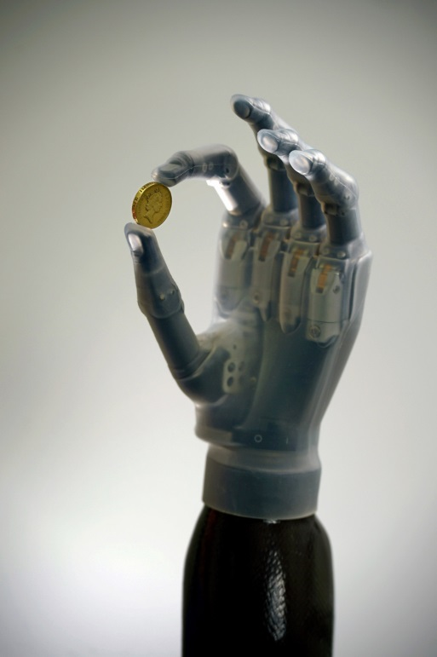
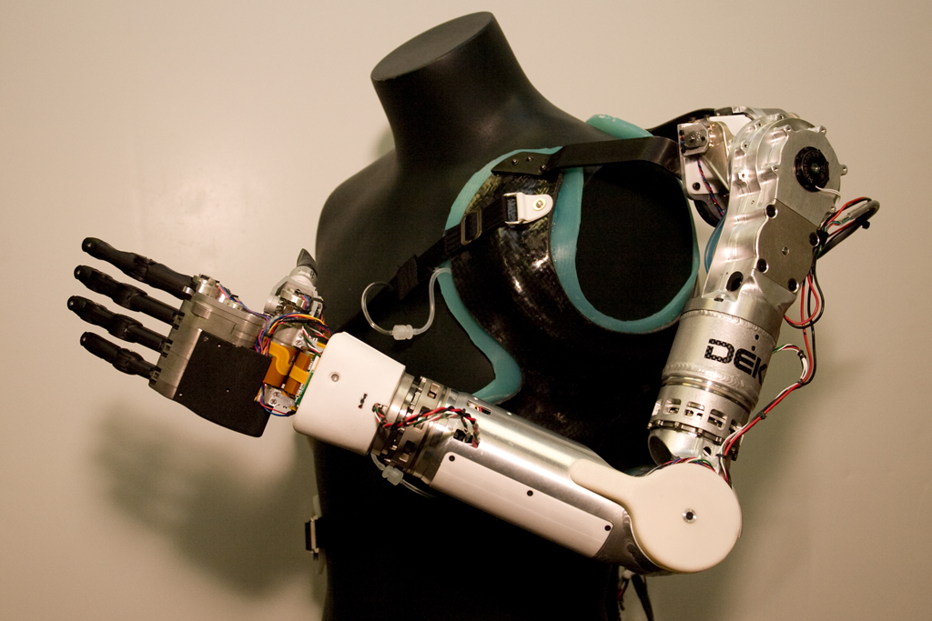
Externally-powered Devices
i-Limb Ultra
DEKA Arm ("Luke Skywalker")
http://qzprod.files.wordpress.com/2013/04/i-limb-ultra-revolution2.jpg?w=1024&h=1538
http://bme240.eng.uci.edu/students/10s/slam5/control.html

Slide 12
Need
40 – 50% rejection rates among users due to
  Discomfort
  Low added functionality
  Late adoption
  High cost
Not using a prosthesis can lead to
  Phantom limb pain
  Limitations in strength, flexibility and endurance
  Overuse of intact limb

Slide 13
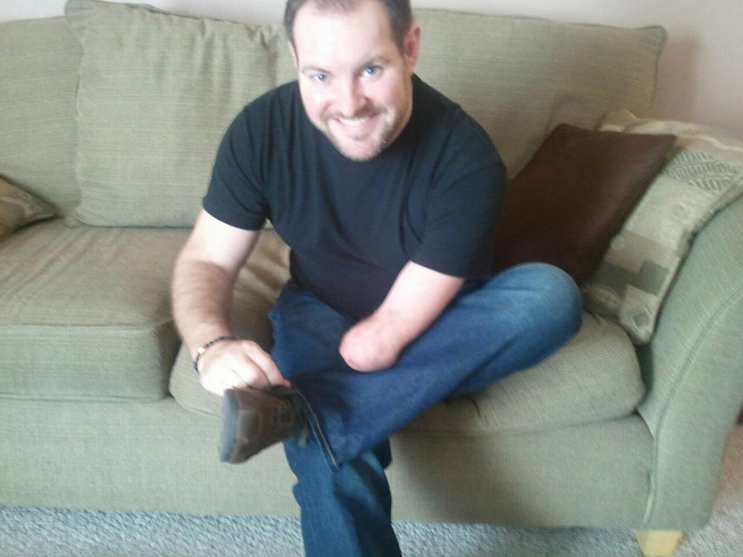
Patient Population
Unilateral
  Only one affected side
Transradial
  Missing arm between the wrist and the elbow
  Through the radius bone
http://www.livingonehanded.com/wp-content/uploads/2012/01/397782_10151128244460603_532525602_22328956_1181628016_n.jpeg

Slide 14
Project Statement
Design a low-cost prosthesis with increased functionality for patients with a unilateral, transradial limb difference

Slide 15
Design Specifications & Scope
Patient Population
  Unilateral transradial limb difference
  Ages 2+
Total Parts Cost
  $150
Weight
  Not to exceed weight of missing limb
Donning and Doffing
  Independently in under 30 seconds
  Does not come off unless intentionally removed

Slide 16
Design Specifications & Scope
Comfort
  Does not cause pain, skin abrasion, or infection
Manufacturing and Assembly
  Technology to manufacture available in US
  Scalable to suit range of limb sizes
Functionality
  Independent thumb movement
  Fingers and thumb close at mouth, waist, and in front
  Thumb and fingers have 2 joints each
    1 degree of freedom per joint
  Individually locking fingers
  Generate 15 N in pinch force

Slide 17
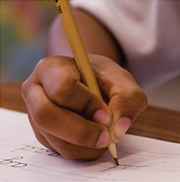
Preliminary Analysis
Joint Moment Calculations
Generate 15 N pinch force
Understand what moments need to be generated at joints in device
Pinch Grip

Slide 18
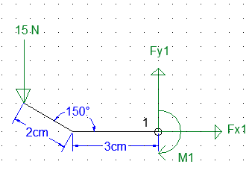
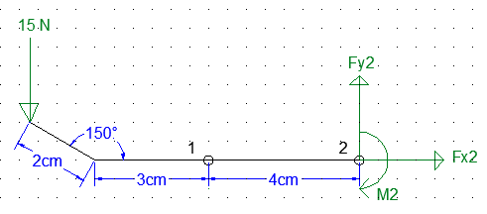
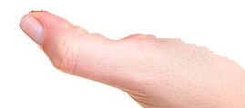


Preliminary Analysis
Joint Moment Calculations
Thumb
Pinch Force
Pinch Force
$$F_{x1}=0 F_{y1}=15N$$
$$\sum{M_{1}=0=−M_{1}+15N \left(3+2\cos{{30}^{°}}\right)}$$
$$M_{1}=71 Ncm$$
$$F_{x2}=0 F_{y2}=15N$$
$$\sum{M_{2}=0=−M_{2}+15N \left(7+2\cos{{30}^{°}}\right)}$$
$$M_{2}=131 Ncm$$

Slide 19
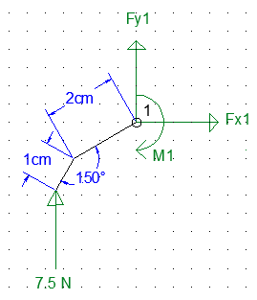
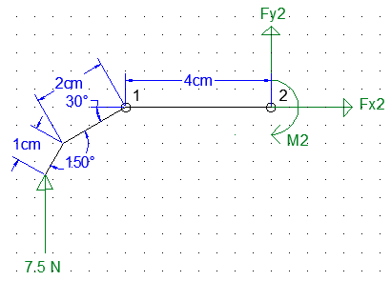
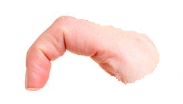
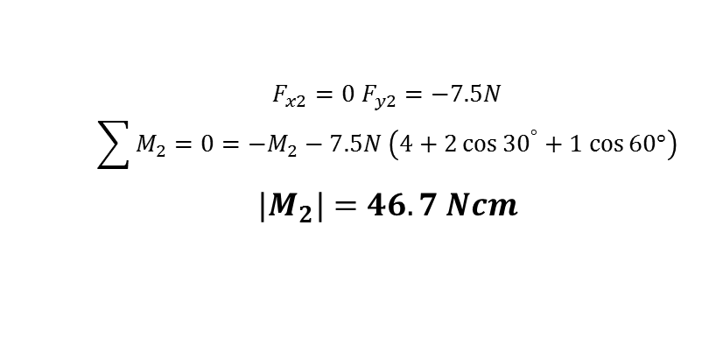
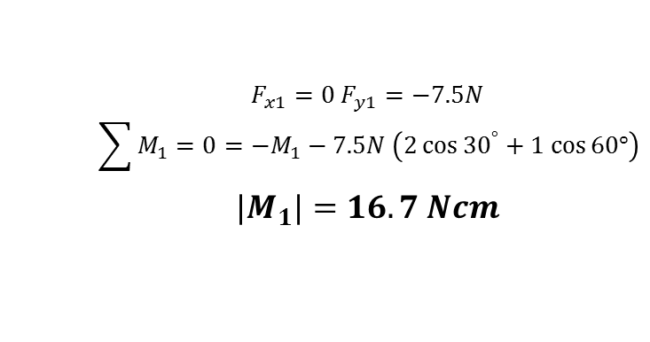
Preliminary Analysis
Joint Moment Calculations
Index and Middle Finger
Pinch Force
Pinch Force
$$F_{x1}=0 F_{y1}=−7.5N$$
$$\sum{M_{1}=0=−M_{1}−7.5N \left(2\cos{{30}^{°}+1 cos⁡60°}\right)}$$
$${|M}_{1}|=16.7 Ncm$$
$$F_{x2}=0 F_{y2}=−7.5N$$
$$\sum{M_{2}=0=−M_{2}−7.5N \left(4+2\cos{{30}^{°}+1 cos⁡60°}\right)}$$
$${|M}_{2}|=46.7 Ncm$$

Slide 20
Design Schedule

Slide 21
Team Responsibilities
Kendall Gretsch
  Preliminary Oral Report
  CAD files
  Control mechanism
  Correspondence with client
Henry Lather
  Progress Oral Report
  Webpage Design
  Terminal Device
  Correspondence with Dr. Klaesner and Leah Vandiver
Kranti Peddada
  Final Oral Report
  Safety Analysis
  Limb Attachment
  Weekly Updates

Slide 22
References
1. Van As, R. Robohand. , 2013.at <http://robohand.net/>
2. Atkins, D. J., D. C. Y. Heard, and W. H. Donovan. Epidemiologic Overview of lndividuals with Upper-Limb Loss and Their Reported Research Priorities. J. Prosthetics Orthot. 8:1–13, 1996.
3. Bartel, D. L., D. T. Davy, and T. M. Keaveny. Orthopaedic Biomechanics. Prentice Hall, 2006.
4. Behrend, C., W. Reizner, J. a Marchessault, and W. C. Hammert. Update on advances in upper extremity prosthetics. J. Hand Surg. Am. 36:1711–7, 2011.
5. Biddiss, E. A., and T. T. Chau. Upper-limb prosthetics: critical factors in device abandonment. Am J Phys Med Rehabil 86:977–87, 2007.
6. Biddiss, E. A., and T. T. Chau. Upper limb prosthesis use and abandonment: a survey of the last 25 years. Prosthet. Orthot. Int. 31:236–57, 2007.
7. Biddiss, E. A., and T. T. Chau. Multivariate prediction of upper limb prosthesis acceptance or rejection. Disabil. Rehabil. Assist. Technol. 3:181–192, 2008.
8. Biddiss, E., D. Beaton, and T. Chau. Consumer design priorities for upper limb prosthetics. Disabil. Rehabil. Assist. Technol. 2:346–357, 2007.
9. Biddiss, E., and T. Chau. The roles of predisposing characteristics, established need, and enabling resources on upper extremity prosthesis use and abandonment. Disabil. Rehabil. Assist. Technol. 2:71–84, 2007.
10. Biddiss, E., P. McKeever, S. Lindsay, and T. Chau. Implications of prosthesis funding structures on the use of prostheses: experiences of individuals with upper limb absence. Prosthet. Orthot. Int. 35:215–24, 2011.
11. Carter, I., W. N. Torrance, and P. H. Merry. Functional results following amputation of the upper limb. Ann. Phys. Med. 10:137–41, 1969.
12. Del Cura, V. O., F. L. Cunha, M. L. Aguiar, and A. Cliquet. Study of the different types of actuators and mechanisms for upper limb prostheses. Artif. Organs 27:507–16, 2003.
13. Dakpa, R., and H. Heger. Prosthetic management and training of adult upper limb amputees. Curr. Orthop. 11:193–202, 1997.
14. Dorrance, D. W. Artificial Hand. Patent: 1042413, 1912.
15. Elkoura, G., and K. Singh. Handrix: Animating the Human Hand. Proc. ACM SIGGRAPH 2003 Symp. Comput. Animat. , 2003.at <http://portal.acm.org/citation.cfm?id=846291>
16. Fryer, C. M., and J. W. Michael. Upper-Limb Prosthetics: Body-Powered Components. In: Atlas of Limb Prosthetics: Surgical, Prosthetic, and Rehabilitation Principles, edited by J. H. Bowker, and J. W. Michael. 1992.
17. Goldstein, B., and J. Sanders. Skin Response to Repetitive Mechanical Stress: A New Experimental Model in Pig. Arch Pys Med Rehabil 79:265–272, 1998.
18. Gow, D. J. MOTOR DRIVE SYSTEM AND LINKAGE FOR HAND PROSTHESIS. Patent: 5888246, 1999.
19. Herberts, P., L. Korner, K. Caine, and L. Wensby. Rehabilitation of unilateral below-elbow amputees with myoelectric prostheses. Scand J Rehabil Med 12:123–8, 1980.
20. Kuiken, T. A., R. Weir, and J. Sensinger. System and Method for Improving the Functionality of Prostheses. , 2007.

Slide 23
References
21. Lam, S. BME 240. , 2010.at <http://bme240.eng.uci.edu/students/10s/slam5/control.html>
22. Malone, J., S. Childers, J. Underwood, and J. Leal. Immediate Postsurgical Management of Upper-Extremity Amputation: Conventional, Electric and Myoelectric Prosthesis. Orthot. Prosthetics 35:1–9, 1981.
23. McDowell, M. a, C. D. Fryar, and C. L. Ogden. Anthropometric reference data for children and adults: United States, 1988-1994. 2009.at <http://www.ncbi.nlm.nih.gov/pubmed/19642512>
24. Morris, R. M. Therapeutic influences on the upper-limb amputee. 2008.
25. Nelson, M. R. Rehabilitation Quick Reference: Pediatrics. New York, NY: Demos Medical Publishing, 2011.
26. Østlie, K., P. Magnus, O. H. Skjeldal, B. Garfelt, and K. Tambs. Mental health and satisfaction with life among upper limb amputees: a Norwegian population-based survey comparing adult acquired major upper limb amputees with a control group. Disabil. Rehabil. 33:1594–607, 2011.
27. Resnik, L., M. R. Meucci, S. Lieberman-Klinger, C. Fantini, D. L. Kelty, R. Disla, and N. Sasson. Advanced upper limb prosthetic devices: implications for upper limb prosthetic rehabilitation. Arch. Phys. Med. Rehabil. 93:710–717, 2012.
28. Sanders, J. E., B. S. Goldstein, and D. F. Leotta. Skin response to mechanical stress: adaptation rather than breakdown--a review of the literature. J. Rehabil. Res. Dev. 32:214–26, 1995.
29. Scott, R. N. MYOELECTRIC CONTROL OF PROSTHESES: A BRIEF HISTORY. , 1992.
30. Selpho, W. Construction of Artificial Hands. Patent: 18021, 1857.
31. Singh, D., M. M. Jadhav, and A. M. Sapkal. Myoelectric Prosthetic Arm Motion (Hand/ Wrist) control System. 1–4.
32. Smit, G., and D. H. Plettenburg. Efficiency of voluntary closing hand and hook prostheses. Prosthet. Orthot. Int. 34:411–27, 2010.
33. Sturup, J., H. C. Thyregod, J. S. Jensen, J. B. Retpen, G. Boberg, E. Rasmussen, and S. Jensen. Prosthetics and Orthotics International. Prosthet. Orthot. Int. 12:50–52, 1988.
34. Webster, G. The bionic hand with a human touch. , 2013.at <http://www.cnn.com/2013/02/01/tech/bionic-hand-ilimb-prosthetic/index.html>
35. Wright, T. W., A. D. Hagen, and M. B. Wood. Prosthetic usage in major upper extremity amputations. J. Hand Surg. Am. 20:619–22, 1995.
36. Biomedical Engineering Design at <http://biomed.brown.edu/Courses/BI108/BI108_2003_Groups/Athletic_Prosthetics/Skeleton_labeled.jpg>

Slide 24
Questions?

