Slide 1
Transradial Prosthetic Arm
Henry Lather
Team Members: Kendall Gretsch and Kranti Peddada
Mentors: Dr. Charles Goldfarb and Dr. Lindley Wall
Website: www.transradialprostheticarm.weebly.com

Slide 2
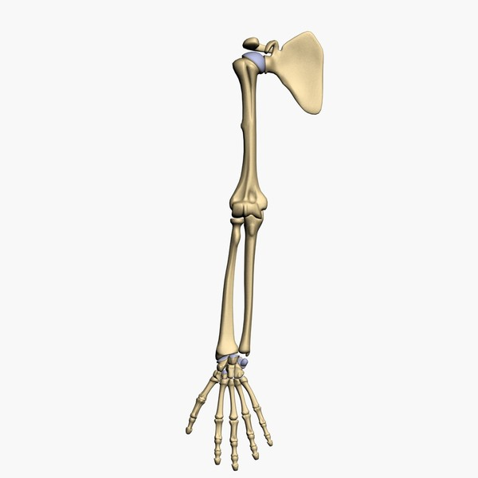
Transradial Limb Amputation
1/3 proximal
preview.turbosquid.com

Slide 3
Need
There are an roughly 10,000 individuals in the US with a transradial limb difference
Most are highly functional, even without a prosthesis
However, many want a prosthesis to augment function
The goal is to give the user a sense of normality and to allow the user to multitask

Slide 4
Design Specifications
Patient Population
  Unilateral, transradial limb difference
  Ages 5+
Total Parts Cost
  Maximum $150
Joints
  Fingers at least one
  Thumb has two
  1 degree of freedom per joint
Comfort
  Does not cause pain, skin abrasions, or infection

Slide 5
Design Specifications (cont.)
Functionality
  Fingers and thumb open and close at least at the mouth, belt, and out front
  Independent thumb movement with key grip
  Ability to lift and hold at least 500 g
Donning and Doffing
  Independently in under 30 seconds
Security
  Does not come off unless intentionally removed
Weight
  Does not exceed weight of missing limb

Slide 6
Design Components We Evaluated
Actuation and Control
Final Design
Socket Design and Fabrication
Suspension
Terminal Device

Slide 7
Design Components We Evaluated
Actuation and Control
Final Design
Socket Design and Fabrication
Suspension
Terminal Device

Slide 8
Actuation and Control Design Options
Body-powered
  Shoulder-controlled
  Elbow-controlled
Externally-powered
  Shoulder-controlled
  Voice-controlled
  Button-controlled
  EMG-controlled

Slide 9
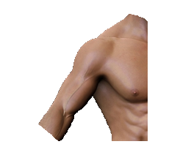
Body-powered,
Shoulder- controlled
3 separate movements
Uncomfortable
Hard to use

Slide 10
Body-powered,
Elbow-controlled
2 separate movements
Very limited range of motion

Slide 11
Externally-powered,
Shoulder-controlled
Sensor
Sensor can distinguish 2 independent movements

Slide 12

Externally-powered,
Voice-controlled
Microphone
Socially disruptive
Would not work in high-noise places

Slide 13
Externally-powered,
Button-controlled
Buttons
Simple and reliable
Requires use of other hand

Slide 14
Comparison of General Features
Body-powered
Externally-powered
✓
Uncomfortable
Can fatigue user
Hard to use
Mechanical parts visible
Hard to Don/Doff
Low cost
Light-weight
Durable
Comfortable
No fatigue
Easy to use
Mechanical parts hidden
Easy to Don/Doff
Higher cost
Heavier
Less durable
✓
✓
✓
✓
✓
✓
✓

Slide 15
Comparison of General Features (cont.)
Body-powered
Externally-powered
✓
Low maintenance
Easily scales to different sizes
Sensory feedback through effort
Higher maintenance
Electronic components do not easily scale
No sensory feedback
✓
✓

Slide 16
Pugh Chart Selection
Actuation and Control |  | Body-powered |  | Externally-powered
 | Weight | Shoulder | Elbow | Shoulder | Voice | Button
Hinderance to Daily Life | 10 | 7 | 3 | 10 | 2 | 2
Comfort | 9 | 1 | 4 | 9 | 10 | 10
Cost | 8 | 10 | 10 | 5 | 5 | 6
Ease of Use | 7 | 4 | 1 | 10 | 10 | 10
Aesthetics | 7 | 2 | 5 | 10 | 10 | 9
Weight | 6 | 10 | 10 | 5 | 5 | 7
Force | 6 | 8 | 7 | 6 | 6 | 6
Don/Doff Time | 6 | 1 | 3 | 8 | 10 | 10
Durability | 4 | 9 | 10 | 7 | 7 | 7
Maintenance | 4 | 8 | 9 | 6 | 5 | 7
Scalability | 2 | 7 | 7 | 5 | 5 | 5
Sensory Feedback | 1 | 9 | 9 | 2 | 2 | 2
Total |  | 406 | 407 | 539 | 476 | 497
Our mentors strongly preferred the Externally-powered, Shoulder-controlled device as well

Slide 17
Design Components We Evaluated
Actuation and Control
Final Design
Socket Design and Fabrication
Suspension
Terminal Device

Slide 18
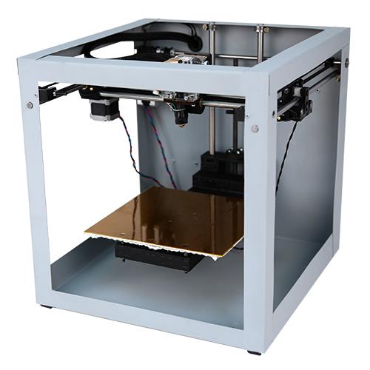
Socket Design and Fabrication: 3D Printed Socket Chosen
Custom made
  Maximize fit and comfort
Process
  3D scan of residual limb
  Negative of scan for socket model
  Print
Fast and inexpensive
Less durable than traditional socket
http://store.solidoodle.com/

Slide 19
Design Components We Evaluated
Actuation and Control
Final Design
Socket Design and Fabrication
Suspension
Terminal Device

Slide 20
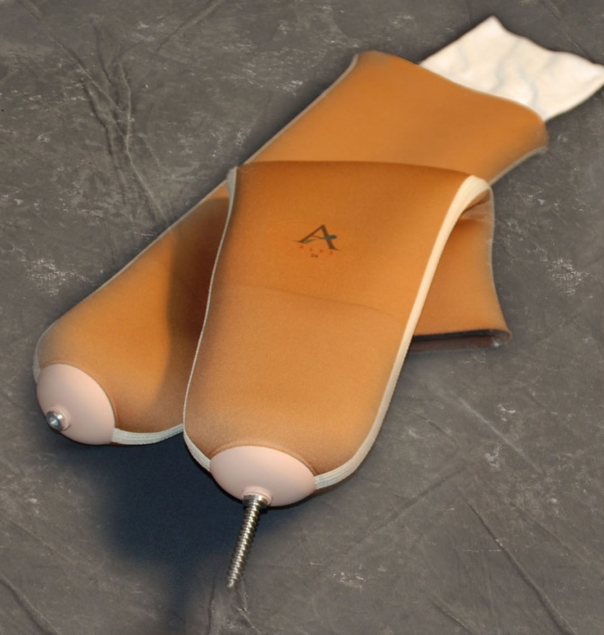
Suspension System Chosen
Sock liner with locking pin
Sock slides on easily with one hand
Locking pin secures socket to limb
http://www.easyliner.com

Slide 21
Design Components We Evaluated
Actuation and Control
Final Design
Socket Design and Fabrication
Suspension
Terminal Device

Slide 22
Terminal Device Options
Customizable Terminal Devices
  Robohand
  Single joint, Lever-based Hand
  The Mitten
Commercial Terminal Devices
  TRS Hook (Buy)
  Hosmer APRL Hook (Buy)
  Hosmer APRL Hand (Buy)
  Soft Hands (Buy)

Slide 23
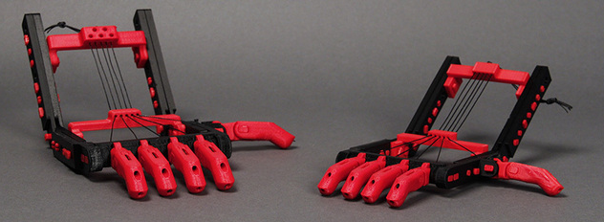
The Robohand
http://www.thingiverse.com/thing:92937
Existing low-cost solution
Open-source CAD files
2 joints in each finger

Slide 24
Single Joint, Lever-based Hand
Designed by our team
Similar in form and function to the Robohand

Slide 25
Single Joint, Lever-based Hand
Each finger has two levers
  One for restoring force
  One for actuating force
Apply Tension

Slide 26
The Mitten
Modeled closely after the Robohand
All 4 fingers move as one unit

Slide 27
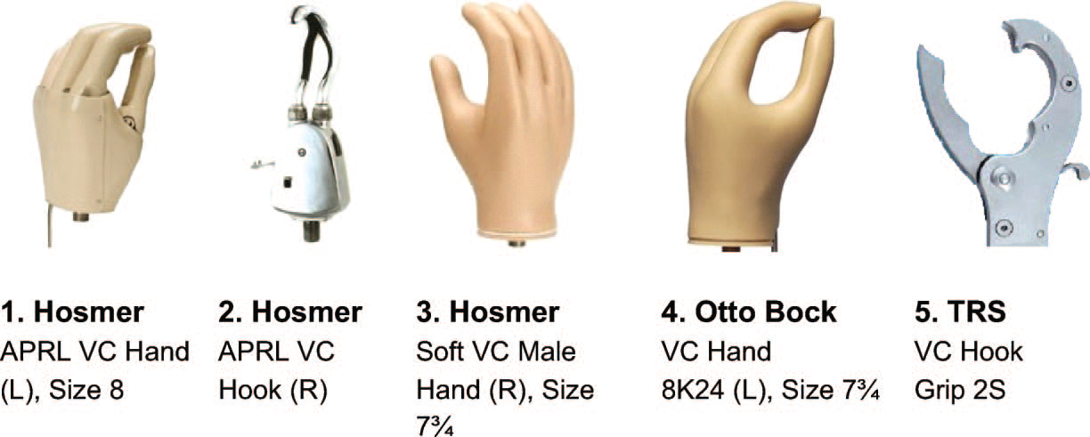
Hooks
Efficient
Unsightly

Slide 28
Hosmer APRL Hand
Decent in all categories
Expensive to buy

Slide 29
Functional "Soft" Hands
Soft, skin-like covering over metal hook
Extremely life-like appearance
Extremely expensive

Slide 30
Pugh Chart Selection
Terminal Devices |  | Customizable Hands |  |  | Commercial Devices
 | Weight | RoboHand | Lever-based | Mitten | TRS Hook | APRL Hook | APRL Hand | Soft Hand
Cost | 10 | 10 | 10 | 10 | 6 | 4 | 4 | 1
Aesthetics | 10 | 6 | 4 | 3 | 1 | 1 | 9 | 10
Weight | 8 | 10 | 10 | 10 | 7 | 8 | 6 | 5
Efficiency | 6 | 5 | 6 | 6 | 10 | 7 | 7 | 1
Durability | 4 | 2 | 3 | 4 | 10 | 9 | 7 | 6
Repair Cost | 3 | 10 | 10 | 10 | 1 | 1 | 1 | 1
Total |  | 308 | 298 | 292 | 229 | 195 | 251 | 183
Our mentors were not enthusiastic about The Mitten
We decided to go with the Robohand because it scored the highest and it has already been proven to work

Slide 31
Chosen Design Components
Externally-powered, shoulder-controlled
Final Design
3D Printed Socket
Sock Liner with Locking Pin
The Robohand

Slide 32
Chosen Design Components
Externally-powered, shoulder-controlled
Final Design
3D Printed Socket
Sock Liner with Locking Pin
The Robohand

Slide 33
Externally-powered,
Shoulder-controlled
IMU
IMU measures linear acceleration and angular velocity

Slide 34
Our Chosen Design
General electronics schematic
Inertial measurement unit = IMU
Shoulder Movement
Shoulder Movement
Data
Thumb Stepper Motor
Micro-controller and Motor Controller
IMU
Fingers Stepper Motor
Power Supply

Slide 35
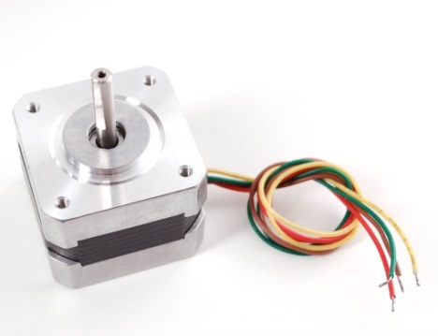
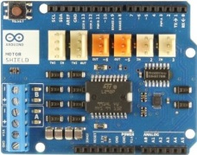
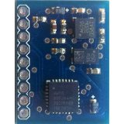
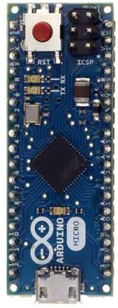

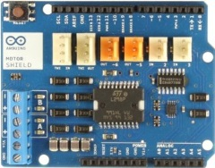
Specific Details of Chosen Design: Possible Components
Arduino R3 Motor Controllers
Adafruit Stepper Motors
The Arduino Micro
Arduino Compatible IMU

Slide 36
Cable-spooling Method
Rotational actuator
Cable is attached to drive shaft
Winds around drive shaft to increase tension when motor is activated
Tension Applied
Motor ON
Spooling

Slide 37
Design Schedule

Slide 38
Team Responsibilities
Kendall Gretsch
  Preliminary Oral Report
  Correspondence with clients
  CAD files
  Socket and Suspension Design
  3D Printing
Henry Lather
  Progress Oral Report
  Webpage Design and Maintenance
  Correspondence with Dr. Klaesner and Leah Vandiver
  Software Development
  Electronics and Robotics Design
Kranti Peddada
  Final Oral Report
  Weekly Updates
  Safety Analysis
  Electronics and Robotics Design

Slide 39
Sources
http://www.hanger.com/prosthetics/services/upperextremity/Pages/FCI.aspx
http://www.amputee-coalition.org/inmotion/jul_aug_01/primer.html
http://www.hanger.com/prosthetics/services/Technology/Pages/Insignia.aspx
http://madebybump.org/#intro
http://www.amputee-coalition.org/inmotion/nov_dec_04/sockettech.html
http://www.openprosthetics.org/suspension
http://www.ossur.com/?PageID=13412
http://www.nlm.nih.gov/cgi/mesh/2011/MB_cgi?mode=&term=Supination
www.vistatek.com
http://www.solidconcepts.com/resources/dg/injection-molding-design-guidelines/
http://www2.mae.ufl.edu/designlab/Lab%20Assignments/EML2322L-Tolerances.pdf
http://www.solidconcepts.com/resources/dg/injection-molding-design-guidelines/
http://sheldonbrown.com/cables.html

Slide 40
Questions?

