Slide 1
Transradial Prosthetic Arm
Kranti Peddada
Team Members: Kendall Gretsch and Henry Lather
Mentors: Dr. Charles Goldfarb and Dr. Lindley Wall
Website: www.transradialprostheticarm.weebly.com

Slide 2
Abbreviated Design Specifications
Patient Population
Unilateral, transradial limb difference
Ages 5+
Total Parts Cost
Maximum $150
Functionality
Hand and thumb open and close at mouth, belt, and in front
Independent thumb movement with key grip
Ability to lift and hold at least 500 g
Weight
Does not exceed weight of missing limb

Slide 3
New Design Specifications
Do-it-yourself, open-source manufacturing and assembly
Robohand Project distribution model
Primarily through online support groups
Advantages
Rapid distribution
Wide audience
Low cost
Highly customizable
Avoids hassles of regulations
Kept in mind when choosing component of final design

Slide 4
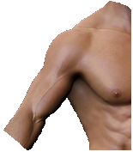
Overview of Design
Inertial Measurement Unit (IMU)
Velcro strap
Wire
Battery Pack

Slide 5
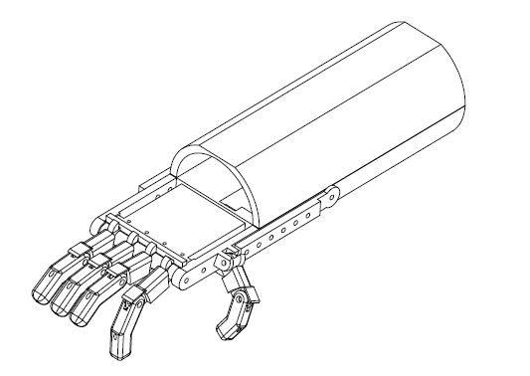
Overview of Design

Slide 6
Analytic Efforts

Slide 7
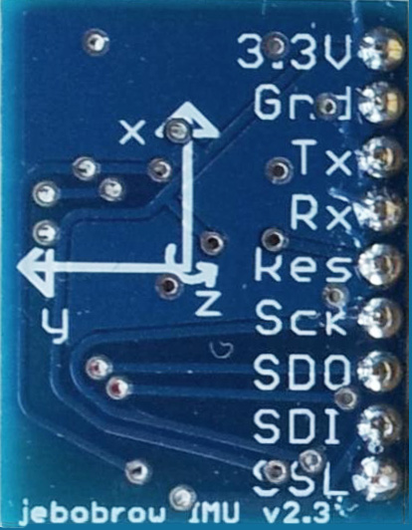
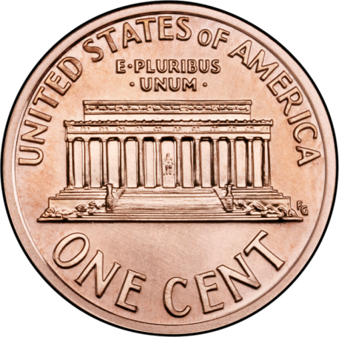
IMU and Sampling Rate
IMU from Prof. James Bobrow of UC Irvine
Internal update rate of 250 Hz using SPI transmission
No disadvantages in using maximum sampling rate
250 Hz chosen
2.54 cm

Slide 8
Power Requirements
IMU = 72 mA
Arduino Micro = 28 mA
Motors at rest = 6.4 mA (x5)
Motors at peak torque and angular velocity = 428 mA (x5)
At rest ≈ 132 mA
At peak ≈ 2.2 A
Chosen voltage regulator can handle constant current of 3 A (maximum of 5 A)

Slide 9
Torque Requirements
$$\sum{M=0=M−0.98 N \left(3\sin{30°}+2\cos{{15}^{°}+2 cos⁡15°}\right)}$$
$$M=5.26 Ncm=0.536 kgcm$$
Our motors can supply up to 2.2 kg-cm

Slide 10
Specific Details

Slide 11
IMU Operation
Outputs yaw, pitch, roll, their time derivatives, and linear acceleration in x, y, and z axes

Slide 12
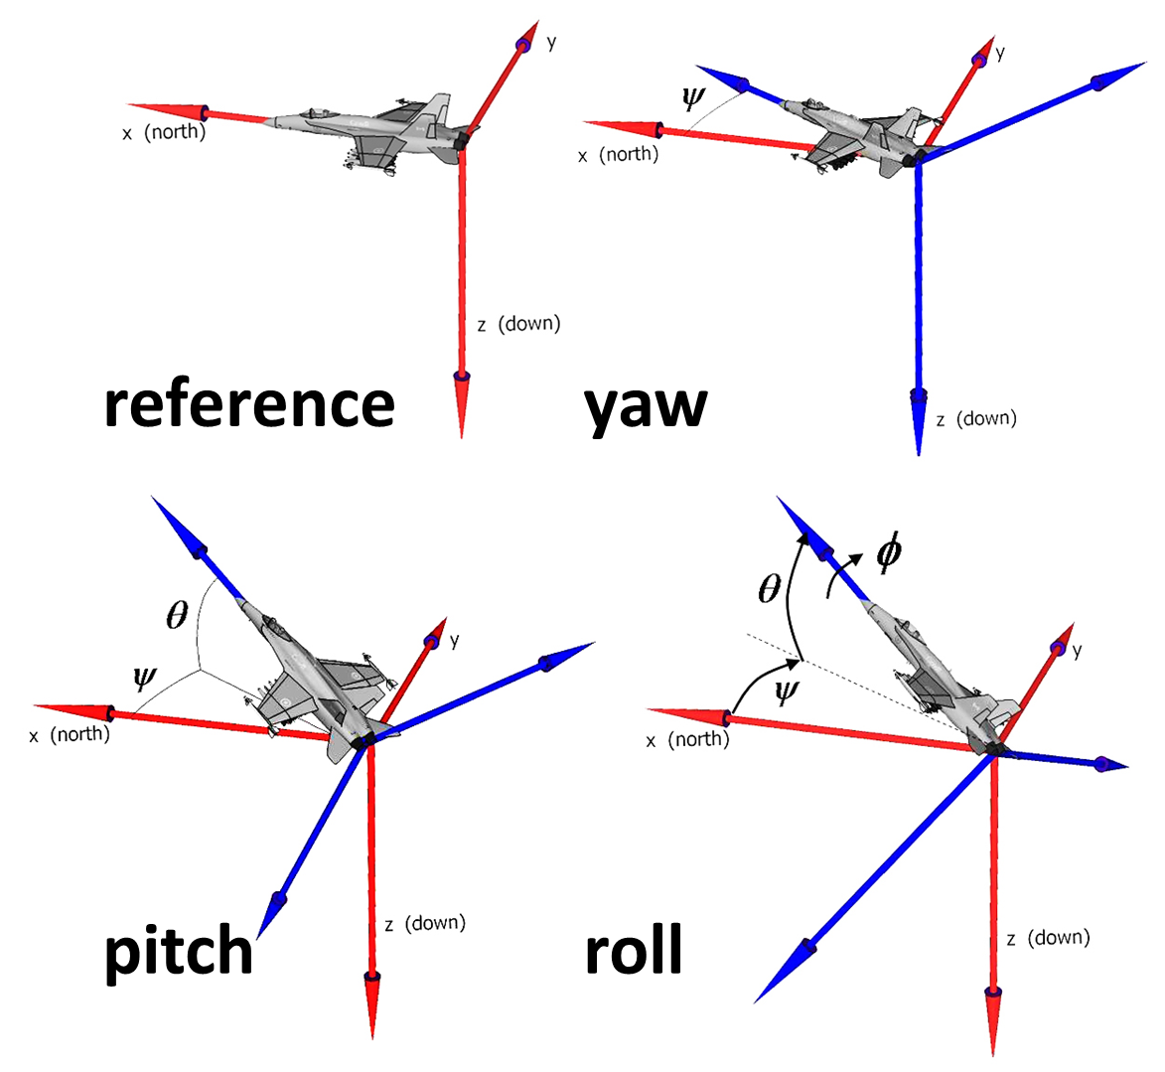

Slide 13
Up/Down Shoulder Movement

Slide 14
Fwd./Rev. Shoulder Movement

Slide 15
Software Flow Chart
Device ON
Initialization:
Roll angle read
Read IMU Data
IF:
Hand closed
Thumb closed
Shoulder up
IF:
Hand open
Thumb closed
Shoulder down
IF:
Hand closed
Thumb closed
Shoulder forward
IF:
Hand closed
Thumb open
Shoulder backward
Hand OPEN
Hand CLOSED
Thumb OPEN
Thumb CLOSED

Slide 16
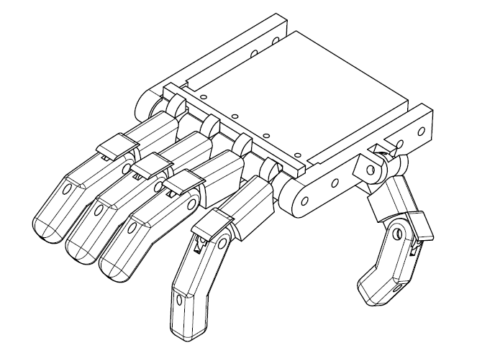
Hand

Slide 17
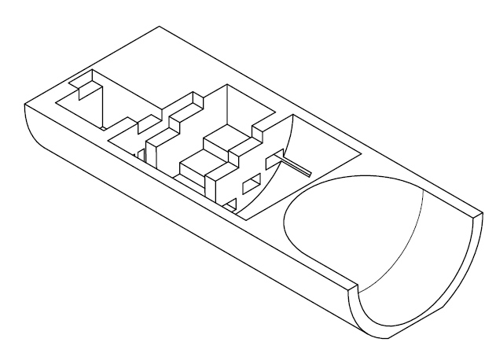
Socket

Slide 18
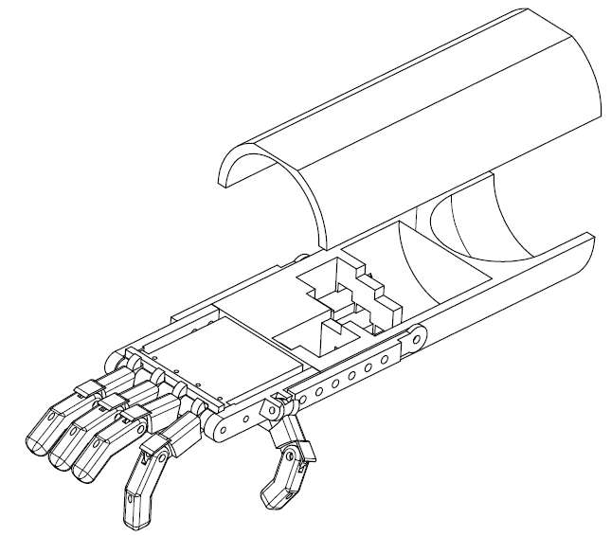
Total Assembly

Slide 19
Safety
No major safety concerns anticipated
Only DC current used
All materials are non-toxic
NiMH batteries are safe
Motors kept distal from residual limb

Slide 20
Costs
Item | Quantity (# or # pkgs.) | Total Cost
Micro servo motor | 5 | $ 46.49
Electrical tape | 1 | $ 0.76
Fishing line | 1 | $ 2.51
Elastic cord (stringing) | 1 | $ 1.63
ABS filament | n/a | $ 6.20
Superglue | 1 | $ 2.49
#6 lock washers | 12 | $ 1.29
#6-32 cap nuts | 2 | $ 2.59
#8 3/8" set screws | 6 | $ 2.33
#8-32 1/2" machine screws | 12 | $ 2.59
#8-32 screw nuts | 8 | $ 2.59
#6-32 6" threaded rod | 1 | $ 3.06
#216-1/2" screw eye | 4 | $ 1.29
Adhesive wrap | 1 | $ 3.75
Total |  | $ 226.12
Item | Quantity (# or # pkgs.) | Total Cost
Inertial measurement unit | 1 | $ 24.99
Velcro straps | 1 | $ 4.15
Stranded 18 AWG wire | 1 | $ 9.24
Printed circuit board | 1 | $ 2.43
Heat shrink tubing | 1 | $ 2.28
AA battery holder | 1 | $ 7.51
AA NiMH rechargeable batteries | 8 | $ 30.88
AA battery charger | 2 | $ 26.77
5V switching voltage regulator | 1 | $ 12.55

Slide 21
3D Printing and Assembly
All parts are off-the-shelf or can be shipped in 2-5 business days
Socket and hand are 3D printed
Less than 15 hours of printing time
Basic soldering experience required
Basic proficiency with hand-held electric tools required
Fitting should be overseen by a Certified Prosthetist

Slide 22
The Prototype

Slide 23
Evaluation of Prototype
Patient Population
Unilateral, transradial limb difference
Ages 5+
Total Parts Cost
$226.12
Functionality
Hand and thumb open and close at mouth, belt, and in front
Independent thumb movement with key grip
Ability to lift and hold 50 g (still testing)
Weight
Weighs 240 g

Slide 24
Intellectual Property
Yes!
New, useful, and non-obvious
However, we want our design to be open-source
Creative Commons License
GNU General Public License

Slide 25
What We Learned
Specific Skills
Henry: Arduino boards, Arduino IDE, SPI transmission, PWM motor control, power supplies, general embedded systems
Kendall: prototyping mechanical systems, Autodesk Inventor, using electric power tools
Kranti: theory of servo and stepper motor control, micro-controller design and theory
Keep design notebooks up-to-date
Use Pugh charts to choose design
1 electrical engineer + 1 mechanical engineer + 1 computer engineer > 3 biomedical engineers

Slide 26
Future Directions
Continue prototyping
Deliver finished prototype to Dr. Goldfarb and Dr. Wall
Find suitable candidate to further test device
Make adjustments as needed
Give candidate the device
Publish all designs and instructions to the internet

Slide 27
Acknowledgements
Prof. Humberto Gonzalez
Patricia Widder
Our mentors:
Dr. Charles Goldfarb
Dr. Lindley Wall

Slide 28
Thank You
Questions?

